Slide 1
Spring Framework

Slide 2
What is Spring Framework?
Spring is a powerful lightweight application development framework used for Java Enterprise Edition (JEE).
Roderick B. Johnson, an Australian computer specialist officially released the Spring Framework in 2002.
Notes:
In a way, it is a framework of frameworks because it provides support to various frameworks such as Struts, Hibernate, Tapestry, EJB, JSF etc. The framework in broader sense can be defined as a structure using which you can solve many technical problems. You can say that, the Spring Framework is a comprehensive tool for supporting applications using Java programming language.

Slide 3
Features Of Spring Framework
Lightweight: Spring Framework is lightweight with respect to size and transparency.
Inversion Of Control (IOC): In Spring Framework, loose coupling is achieved using Inversion of Control. The objects give their own dependencies instead of creating or looking for dependent objects.
Aspect Oriented Programming (AOP): By separating application business logic from system services, Spring Framework supports Aspect Oriented Programming and enables cohesive development.
Container: Spring Framework creates and manages the life cycle and configuration of application objects.
MVC Framework: Spring Framework is a MVC web application framework. This framework is configurable via interfaces and accommodates multiple view technologies.
Transaction Management: For transaction management, Spring framework provides a generic abstraction layer. It is not tied to J2EE environments and it can be used in container-less environments.
JDBC Exception Handling: The JDBC abstraction layer of the Spring Framework offers an exception hierarchy, which simplifies the error handling strategy.

Slide 4
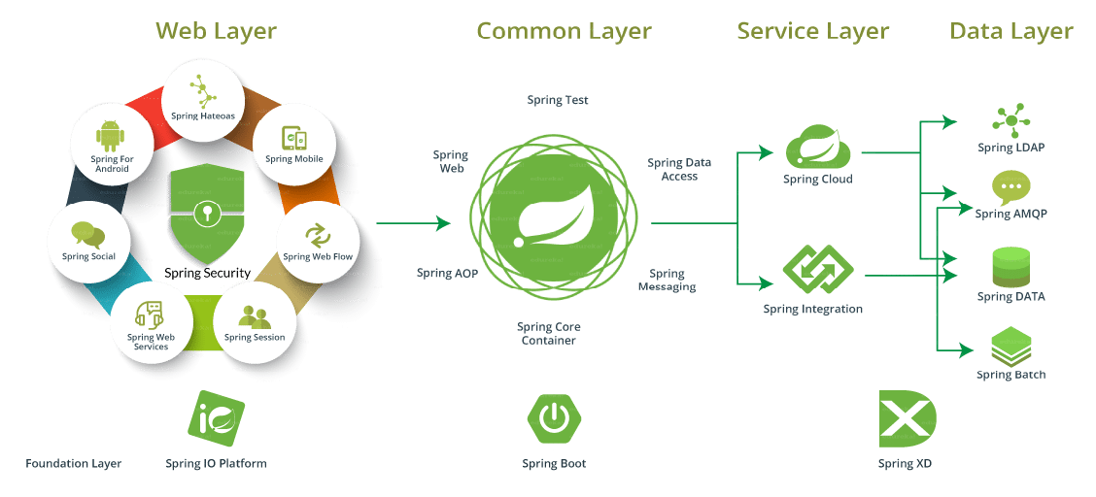
Various Projects Undertaken By Spring

Slide 5
Advantages Of Using Spring Framework
Works on POJOs (Plain Old Java Object) which makes your application lightweight.
Provides predefined templates for JDBC, Hibernate, JPA etc., thus reducing your effort of writing too much code.
Because of dependency injection feature, your code becomes loosely coupled.
Using Spring Framework, the development of Java Enterprise Edition (JEE) applications became faster.
It also provides strong abstraction to Java Enterprise Edition (JEE) specifications.
It provides declarative support for transactions, validation, caching and formatting.

Slide 6
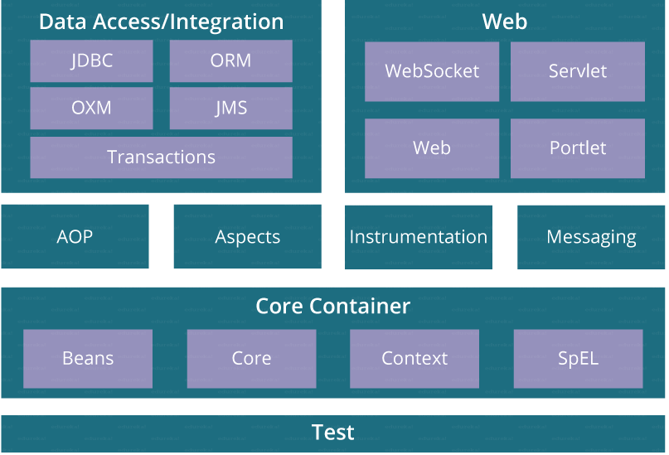
Spring Framework Architecture
Notes:
As you can see in the diagram below, Spring Framework architecture is an arranged layered architecture which consists of different modules. All the modules have their own functionalities that are utilized to build an application. There are around 20 modules which are generalized into Core Container, Data Access/ Integration, Web, AOP (Aspect Oriented Programming), Instrumentation, and Test. Here, developer is free to choose the required module. It’s modular architecture enables integration with other frameworks without much hassle. Let’s now explore these modules in details. I will start with the Core Container on which rest of the modules are constructed, then I’ll talk about Data Access followed by Web and AOP. Finally, I will discuss on some of the miscellaneous modules.

Slide 7
Modules Of Spring Framework
Core Container
This container has the following four modules :
Spring Core: This module is the core of the Spring Framework. It provides implementation for features like IoC (Inversion of Control) and Dependency Injection with singleton design pattern.
Spring Bean: This module provides implementation for the factory design pattern through BeanFactory.
Spring Context: This module is built on the solid base provided by the Core and the Beans modules and is a medium to access any object defined and configured.
Spring Expression Languages (SpEL): This module is an extension to expression language supported by Java server pages. It provides a powerful expression language for querying and manipulating an object graph, at runtime.

Slide 8
Spring Data Access/ Integration
It consists of the following five modules:
JDBC: This module provides JDBC abstraction layer which eliminates the need of repetitive and unnecessary exception handling overhead.
ORM: ORM stands for Object Relational Mapping. This module provides consistency/ portability to our code regardless of data access technologies based on object oriented mapping concept.
OXM: OXM stands for Object XML Mappers. It is used to convert the objects into XML format and vice versa. The Spring OXM provides an uniform API to access any of these OXM frameworks.
JMS: JMS stands for Java Messaging Service. This module contains features for producing and consuming messages among various clients.
Transaction: This module supports programmatic and declarative transaction management for classes that implement special interfaces and for all your POJOs. All the enterprise level transaction implementation concepts can be implemented in Spring by using this module.

Slide 9
Spring Web
Web layer includes the following modules:
Web: This module using servlet listeners and a web-oriented application context, provides basic web-oriented integration features like multi-part file upload functionality and the initialization of the IoC container.
Web-Servlet: This module contains Model-View-Controller (MVC) based implementation for web applications. It provides all other features of MVC, including UI tags and data validations.
Web-Socket: This module provides support for WebSocket based and two-way communication between the client and the server in web applications.
Web-Portlet: This module is also known as Spring-MVC-Portlet module. It provides the support for Spring based Portlets and mirrors the functionality of a Web-Servlet module.

Slide 10
Aspect Oriented Programming (AOP)
AOP language is a powerful tool which allows developers to add enterprise functionality to the application such as transaction, security etc. It allows us to write less code and separate the code logic. AOP uses cross-cutting concerns.

Slide 11
Instrumentation
This module provides class instrumentation support and class loader implementations that are used in certain application servers.

Slide 12
Test
This module supports the testing of Spring components with JUnit or TestNG. It provides consistent loading of Spring ApplicationContexts and caching of those contexts. It also provides mock objects that we can use to test our code in isolation.

Slide 13
First Spring Application
Follow five simple steps:
Create the Bean.java class
Create a XML/ configuration file
Create the main class
Load the required jar files
Run the application
Let’s get started with the first step.

Slide 14
Step I: Creating the Bean class:
For this go to File > New > Java Project.
Now to create a package, right click on Project > New > package.
Name the package and again right click on New > Class.
Here is an example of Student bean class.

Slide 15
package firstSpring.bean;
public class StudentBean
{
String name; public String getName()
{ return name; }
public void setName(String name)
{ this.name = name; }
public void displayInfo()
{ System.out.println("Hello: "+ name); }
}
Notes:
This is a simple bean class, containing only one property name with its getters and setters method. This class contains one extra method named displayInfo() that prints the student name by the hello “student name” message.

Slide 16
Step II: Create a XML file
Right click on src > New > Other > XML File
<?xml version="1.0" encoding="UTF-8"?>
<beans xmlns="http://www.springframework.org/schema/beans"
xmlns:xsi="http://www.w3.org/2001/XMLSchema-instance"
xsi:schemaLocation="http://www.springframework.org/schema/beans
http://www.springframework.org/schema/beans/spring-beans.xsd">
<bean id="studentbean" class="firstSpring.bean.StudentBean">
<property name="name" value="Abhishek"></property>
</bean>
</beans>
The <bean> tag is used to define the bean for the given class.
The <property> tag is a subelement of bean, and specifies the property of the Student class. The value specified in the property element will be set in the Student class object by the IoC container.

Slide 17
Step III: Create the main class
Right click on package > New > Class
Here is an example of StudentDemo class:
package firstSpring.demo;
import org.springframework.context.ApplicationContext;
import org.springframework.context.support.ClassPathXmlApplicationContext;
import firstSpring.bean.StudentBean;
public class StudentDemo
{
public static void main(String[] args)
{
ApplicationContext appCon=new ClassPathXmlApplicationContext("META-INF\\StudentConfig.xml");
StudentBean factory=(StudentBean)appCon.getBean("studentbean");
factory.displayInfo();
}
}

Slide 18
Spring IoC Container
Spring IoC stands for Inversion of Control. It is the heart of the Spring Framework. The important tasks performed by the IoC container are:
Instantiating the bean
Wiring the beans together
Configuring the beans
Managing the bean’s entire life-cycle

Slide 19
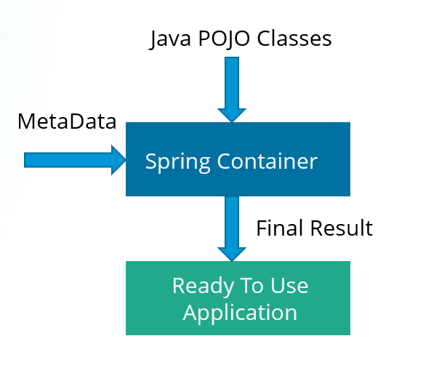
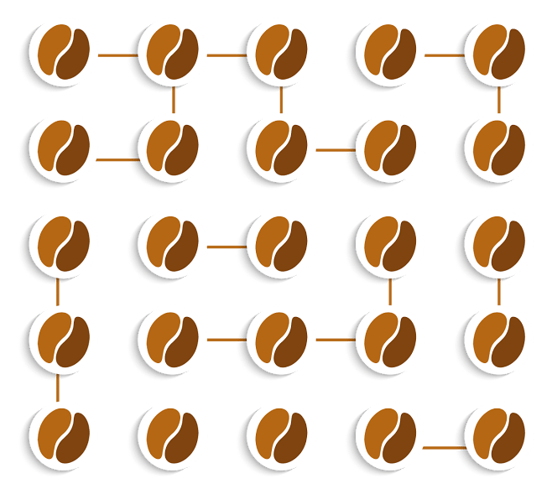
Here is a diagrammatic representation of how beans are wired together by IoC container and An Abstract View of the working of Spring framework.
Notes:
The IoC container receives metadata from either an XML file, Java annotations, or Java code and works accordingly. IoC adds the flexibility and control of application, and provides a central place of configuration management for Plain Old Java Objects (POJO) of our application. This diagram represents an abstract view of the working of Spring Framework. It shows how Spring makes use of Java POJO classes and configuration metadata to produce a fully configured and executable system or application.

Slide 20
IoC containers
There are two types of IoC containers:
BeanFactory
ApplicationContext

Slide 21
BeanFactory
It is an interface defined in org.springframework.beans.factory.BeanFactory.
Bean Factory provides the basic support for Dependency Injection.
It is based on factory design pattern which creates the beans of any type.
BeanFactory follows lazy-initialization technique which means beans are loaded as soon as bean factory instance is created but the beans are created only when getBean() method is called.
The XmlBeanFactory is the implementation class for the BeanFactory interface. To use the BeanFactory, you need to create the instance of XmlBeanFactory class as shown below:
BeanFactory beanFactory = new XmlBeanFactory(new ClassPathResource("beans.xml"));

Slide 22
ApplicationContext
It is an interface defined in org.springframework.context.ApplicationContext.
It is the advanced Spring container and is built on top of the BeanFactory interface.
ApplicationContext supports the features supported by Bean Factory but also provides some additional functionalities.
ApplicationContext follows eager-initialization technique which means instance of beans are created as soon as you create the instance of Application context.
The ClassPathXmlApplicationContext class is the implementation class of ApplicationContext interface. You need to instantiate the ClassPathXmlApplicationContext class to use the ApplicationContext as shown below:
ApplicationContext context=new ClassPathXmlApplicationContext("beans.xml");

Slide 23
Dependency Injection
A design pattern that removes the dependency from the code. That is, the Spring Framework provides the dependencies of the class itself so that it can be easy to manage and test the application.
You can provide information from external source such as XML file. Here, you do not create the objects instead you just define how they should be created and IoC container will create the objects for you.
Dependencies can be injected in two ways:
By constructor
By setter method

Slide 24
Dependency Injection – By Constructor
The <constructor-arg> subelement of <bean> is used for constructor injection. e.g:
<constructor-arg value="101" type="int"></constructor-arg>
By default when the Spring container loads the bean, it instantiates the bean with the default constructor. But you can also define a constructor argument in bean definition, using an argument constructor.

Slide 25
Dependency Injection- By Setter Method
The <property> subelement of <bean> is used for setter injection.e.g:
<property name="id" value="101"></property>
Setter-based Dependency Injection is accomplished by the container calling setter methods on your beans after invoking a no-argument.

